Slide 1
Body Fat Calculator
STAT 628 Module 2 Group 11

Slide 2
Data Exploration
Searched for outliers by summary statistics and plots
Imputed abnormal data by the existing relationship

Slide 3
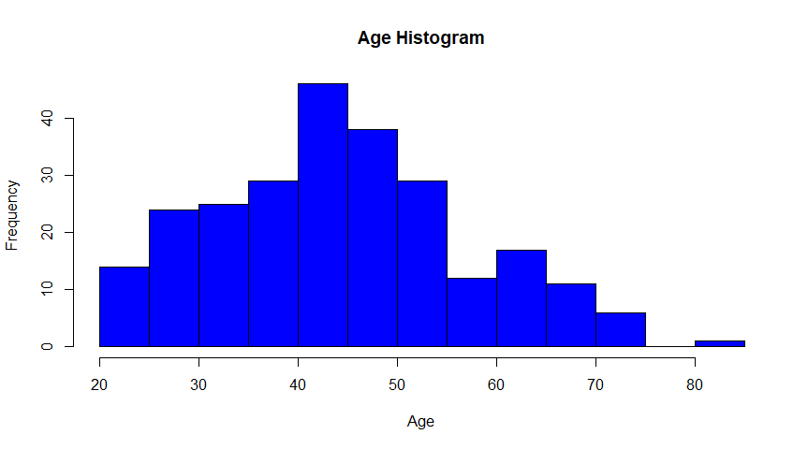
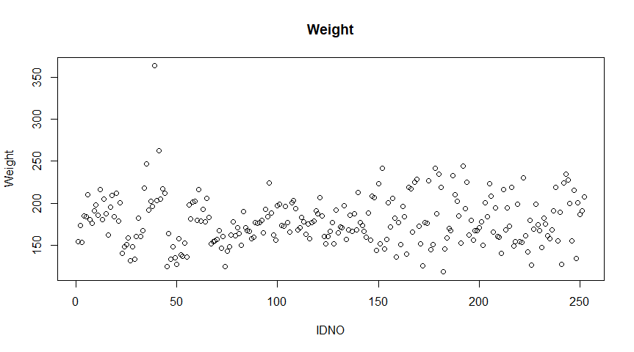
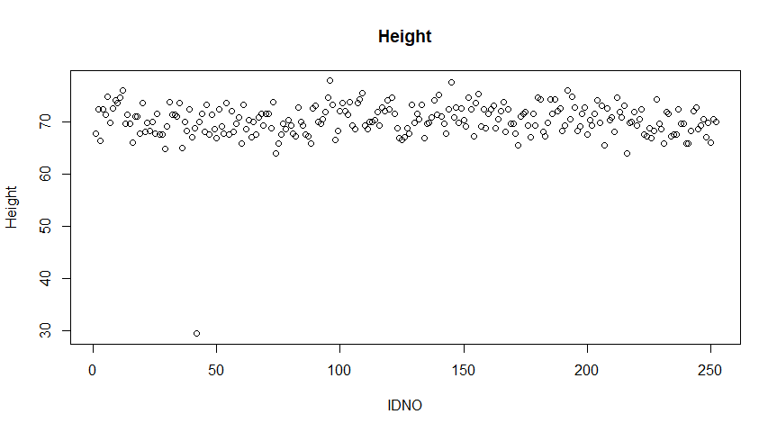
Plots of Age, Weight and Height Variables

Slide 4
Outliers
IDNO | Reason | How to proceed
39 | Has the max value for weight adiposity, neck, chest, abdomen, hip, thigh, and knee, clearly an outlier from the plot | Remove from data
42 | Height unreasonably low | Attempt to recover
79 | The sole individual with age above 80 | Remove from data

Slide 5

Recover height using weight+adiposity
Notice that IDNO42 has height 29.5 inches/74.93cm, which is unreasonable
Can recover using $Adiposity=\frac{703∙Weight(lb)}{Heigh{t(inch)}^{2}}=\frac{Weight\left(kg\right)}{Height{\left(cm\right)}^{2}}$
We have:
IDNO | Original | Recovered | Reasonable?
42 | 29.5 inches/74.93cm | 69.43 inches/176.34cm | Yes

Slide 6
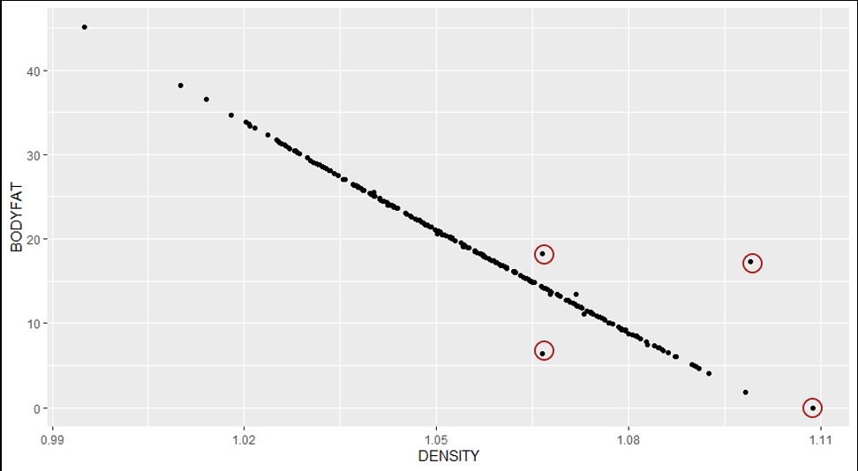

Bodyfat variable
There is a direct relationship between body fat and density that is shown by Siri’s equation: $Bodyfat=\frac{495}{Density}−450$
Recovered abnormal data by Siri’s equation
Removed data of outliers after recovery

Slide 7
Recover data using Siri’s equation
Clearly, some values are wrong as they deviate from the line
There are issues for IDNO48, 76, 96, 182
Using Siri’s Equation, we have the following:
IDNO | Original | Recovered | Reasonable and Keep?
48 | 6.4 | 14.1 | Yes
76 | 18.3 | 14.1 | Yes
96 | 17.3 | 0.4 | No
182 | 0 | -3.6 | No

Slide 8
Bodyfat data
From Google, we learn that bodyfat percentage <3% is unreasonable
Using this, we can filter out the data for IDNO172, which has bodyfat value of 1.9

Slide 9
Data Cleaning Summary
We deleted IDNO39, 79, 96, 172, 182 from data
We recovered data for IDNO42, 48, 76
Final cleaned data: n=247 individuals with all the original predictors

Slide 10
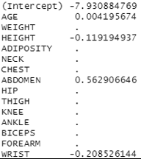
Variable Selection
Used LASSO for variable selection
Age, Height, Abdomen and Wrist are the most important variables

Slide 11
Age variable
By the article Effect of Aging on Body Fat, percentage body fat increased slightly between ages 20 to 39 and 40 to 84.
Changed Age into a categorical variable with age 40 as cutoff

Slide 12
Models for Bodyfat
Tried the following models and compare their performance:
1. Random Forest
2. XGBoost
3. Multiple Linear Regression using Leave-one-out Cross Validation

Slide 13
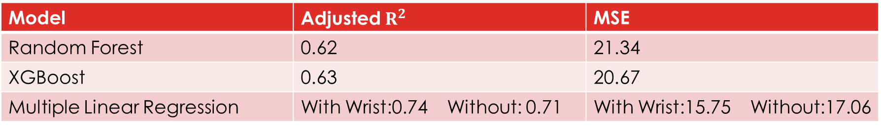
Model Performance
Based on the results above, we proceed with using Multiple Linear Regression Model
Note that we tried one model with wrist and another without so that wrist can be an optional input in the Shiny App for user convenience
Model | Adjusted $R^{2}$ | MSE
Random Forest | 0.62 | 21.34
XGBoost | 0.63 | 20.67
Multiple Linear Regression | With Wrist:0.74 Without: 0.71 | With Wrist:15.75 Without:17.06

Slide 14

Final Model
$Bodyfat \%=9.39+0.71Abdomen−0.14Height −1.74Wrist+1.14\left(Age 40\sim 80\right)$
Simpler and user-friendly model without wrist: $Bodyfat \%=−1.73+0.63Abdomen−0.21Height +0.75\left(Age 40\sim 80\right)$
Notes:
Or, if the user wants a
Some results of the model:
1cm increase in abdomen -> body fat increase by 0.707%
1cm increase in height -> body fat decrease 0.138%
1cm increase in wrist -> body fat decrease 1.742%

Slide 15
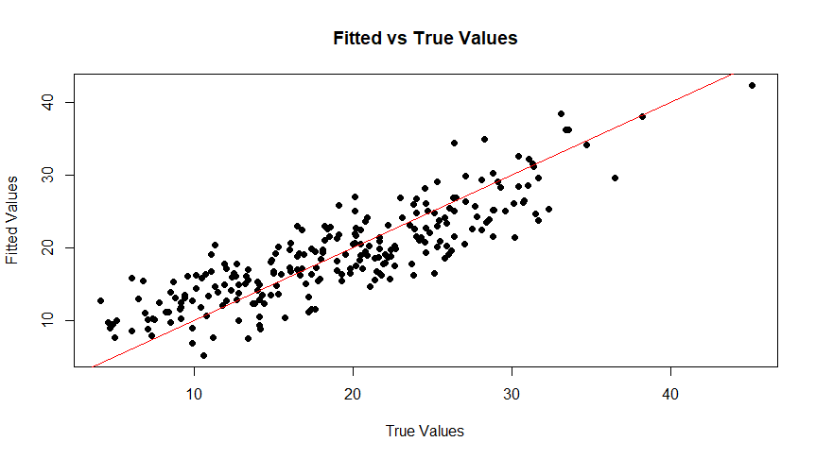
Model Plot

Slide 16

Examples
Average American male (175.3cm height, 101.25cm waist, 18.42cm wrist): $≤$40: 25.76% 95% CI:[24.60%, 26.91%]
$>$40: 26.91% 95% CI:[26.08%, 27.73%]
Usain Bolt (35 years old, 195cm height, 83.8cm waist, 18.42cm wrist ): Body fat 9.58% 95% CI:[8.06%, 11.09%]

Slide 17
Model Diagnostics
Check Multiple Linear Regression assumptions: - Normality - Homoscedasticity - Multicollinearity

Slide 18
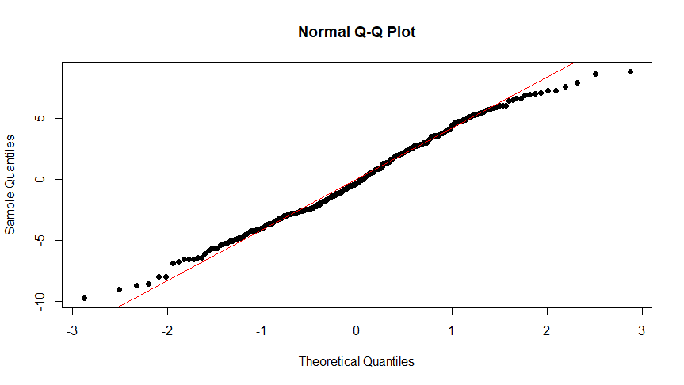
Normality
We look at QQplot for residuals as well as perform the Shapiro test
Shapiro test p-value: 0.076

Slide 19
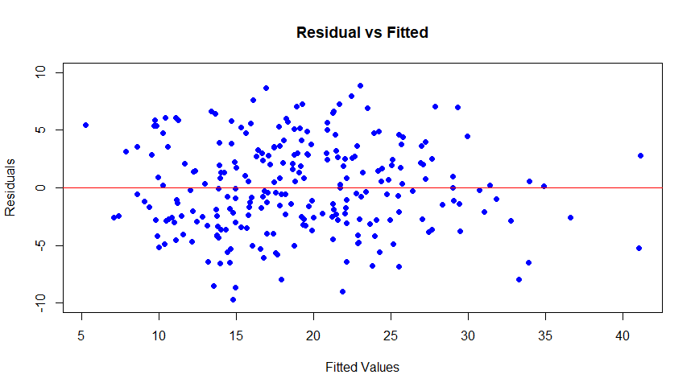
Homoscedasticity
Residual plot:

Slide 20
Multicollinearity
Used the variance inflation factor (VIF) to check multicollinearity
VIF value for each variable is lower than 2
Conclusion: No multicollinearity issue

Slide 21

Strengths/weaknesses
Strengths: - Decent $R^{2}$ - Simple and easy to use and interpret
Weaknesses: - It might not generalize well for individuals outside the range of our data, such as people <20 or > 80 - Dataset population is low

Slide 22
Shiny app demonstration
https://tinghuixu1114.shinyapps.io/bodyfatcalculator-group11/

Slide 23
Thank you!

